Slide 1
Feminist Literary Criticism
An Introduction to Feminist Literary Theory

Slide 2
Reader Response
Asks you to critically analyze a text from your perspective and to reflect on your bias and why you interpret a text a certain way.

Slide 3
Literary Criticisms
A literary criticism asks YOU the reader to look at a piece of literature from a different perspective.
You have to take away YOUR bias (your set of experiences and what you think) and replace it with a different, new bias or perspective.
For example: if I ask you, ‘Is The Hunger Games’ a good movie? You might say yes or no. If I ask you, “As a woman, is the Hunger Games a good movie?” you might have a different answer!

Slide 4
Purdue University
Feminist criticism is concerned with "...the ways in which literature (and other cultural productions) reinforce or undermine the economic, political, social, and psychological oppression of women" (Tyson)

Slide 5
What is Feminist Literary Criticism?
This school of theory looks at how aspects of culture are inherently male dominated and this critique attempts to reveal the explicit and implicit way men and women treat women in their writing about women.

Slide 6
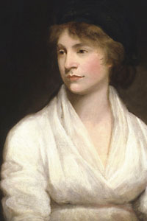
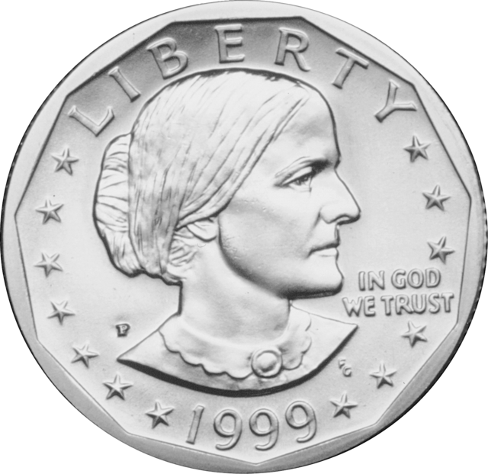
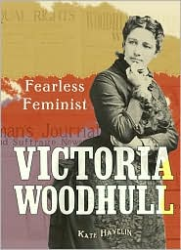
1st School of Feminist Thought
late 1700s-early 1900's: writers like Mary Wollstonecraft highlight the inequalities between the sexes.
Activists like Susan B. Anthony and Victoria Woodhull contribute to the women's suffrage movement, which leads to National Universal Suffrage in 1920 with the passing of the Nineteenth Amendment in the United States.

Slide 7
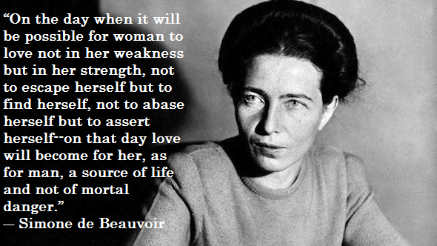
2nd Generation of Feminist Thought
Early 1960s-late 1970s: building on more equal working conditions necessary in America during World War II
The National Organization for Women (NOW), formed in 1966
Feminist political activism. Writers like Simone de Beauvoir (Le deuxième sexe, 1972) and Elaine Showalter established the groundwork for the dissemination of feminist theories dove-tailed with the American Civil Rights movement

Slide 8
3rd Wave of Feminism
Early 1990s-present: resisting the perceived over generalized, over simplified ideologies and a white, heterosexual, middle class focus of second wave feminism
Third wave feminism borrows from post-structural and contemporary gender and race theories to expand on marginalized populations' experiences.
Writers like Alice Walker work to "...reconcile it [feminism] with the concerns of the black community...[and] the survival and wholeness of her people, men and women both, and for the promotion of dialog and community as well as for the valorization of women and of all the varieties of work women perform" (Tyson 97).

Slide 9
Feminist Theory
Read “Subjects of Sex / Gender / Desire” and answer the following 3 questions.
What is feminism for the author?
What role does ‘power’ play in feminist discourse/politics?
Explain what the author says gender construction is vs. sexual construction

Slide 10
4th Wave Feminism
A phase of feminism that began around 2013 and is characterized by a focus on the empowerment of women and the use of internet tools.
Together we will watch the following link.
What do you think is the main change in feminism in 4th wave? Have you experienced any of this?

Slide 11
What to Look For In Literature:
How is the relationship between men and women portrayed?
What are the power relationships between men and women (or characters assuming male/female roles)?
How are male and female roles defined?
What constitutes masculinity and femininity?
How do characters embody these traits?
Do characters take on traits from opposite genders? How so? How does this change others’ reactions to them?

Slide 12
Questions Continued
What does the work reveal about the operations (economically, politically, socially, or psychologically) of patriarchy?
What does the work imply about the possibilities of sisterhood as a mode of resisting patriarchy?
What does the work say about women's creativity?
What does the history of the work's reception by the public and by the critics tell us about the operation of patriarchy?
What role the work play in terms of women's literary history and literary tradition?

Slide 13
Doing a Feminist Critique
I suggest you choose \3 questions from the previous list and ask those questions of characters in Jubilee.
Ex. What are the power relationships between men and women (or characters assuming male/female roles)?
- Compare the relationship between Andrea and Max. Who takes on the more traditionally masculine and who takes on the more feminine roles?

Slide 14
Your Analysis
How do you think women are portrayed in Jubilee?
In your groups choose 3 questions from Slides 9 and 10 and ask them of the story and characters in Jubilee.
Based on these questions and your group discussion, judge the treatment of women in the story. What message might the author be sending? Explain.

Slide 15
Analysis #2
Individually choose 2 questions from Slides 9 and 10.
Look at the story Yesterday and evaluate it from a feminist perspective using the answers from your questions to evaluate the message being sent by the author about women in the story.
Your analysis should be 2 paragraphs (one per question).

