Slide 1
The Environment
And Economics

Slide 2
Sustainable Development
Is the relationship between economics and the environment. How can we develop, but maintain our respect for the environment?
Is this possible? Discuss in your groups for 2 minutes.

Slide 3
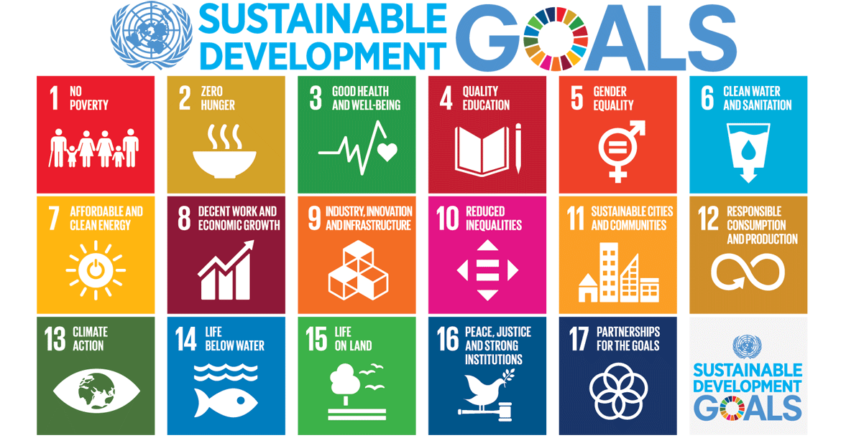
Sustainable Development Continued
The United Nations terms these as sustainable development goals. What is preventing us from achieving them?

Slide 4
Carrying Capacity
William Catton wrote that carrying capacity is the number of people the earth’s resources can support if managed effectively. In other words resources must be managed efficiently and effectively so that the environment is not harmed to the extent it can no longer sustain the human population.

Slide 5
Our World In Data
Go to the link on our website to Our World In Data. Examine the charts and graphs. Draw one conclusion (inference) and be prepared to share with the class.

Slide 6
Externalities
We discussed externalities at the beginning of the course, but no were more do they have effects than in the environment.
Review: “An externality is a side effect of the productive process that is experienced by a 3rd party who does not participate, as either a consumer or producer.”

Slide 7
Positive Externalities
A transaction that provides a benefit to a third party.
(Example: Line 5 Eglinton)

Slide 8
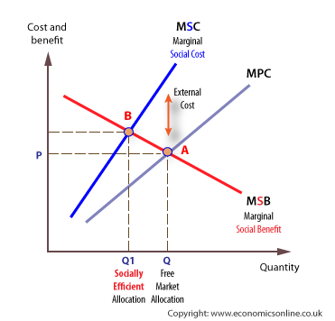
Negative
- Those not engaged in the transaction suffer a cost that is imposed.
External Cost – The gap is the External cost. To be efficient we must include call costs which will then shift the MPC to the left decreasing revenues.
Marginal Social Cost (MSC) – The cost that is associated with harm to society (perhaps toxic fumes sent into the environment).
Marginal Private Cost (MPC) – Only the private costs incurred by the firm ignoring externalities.
Explain the difference between Q and Q1.

Slide 9
Why?
Negative externalities are conducted beyond the socially optimal level because the activity will occur up to the point where the marginal private benefit = the marginal private cost and the marginal private cost is lower than the marginal social cost. In other words, if the social cost is viewed as ‘economically acceptable.’

Slide 10
Solving the Problem: Public Policy
Regulations: limiting activities with negative externalities.
Taxes: on activities that have negative externalities.
- Watch the video and then read the article. Why are people so opposed to this? Do you agree?
Sales of Licenses: permit socially optimal levels of the negative externalities.

Slide 11
Public & Merit Goods
Public
Non-excludable and non-rival
Ex: Parks & Roads
Merit
possess social benefits beyond private demand for them
Ex: Fire protection, education, and health care

Slide 12
Ways to Help the Environment
Taxes, Subsidies, Regulation, Pollution Credits
- In your groups you will be assigned one of these to look up. Find its benefits and its drawbacks. Be prepared to share with the class.

