Slide 1
Elements of a Criminal Offence
The 6 Elements

Slide 2
Actus Reus & Mens Rea
Actus Reus: A Latin phrase meaning ‘wrongful deed’. It is the physical or guilty act, omission, or state of being that constitutes a crime.
Mens Rea: A Latin phrases meaning ‘a guilty mind’. The mental element of one’s criminal actions.
The Crown must prove both beyond a reasonable doubt. The crown must prove the identity of the accused for example and based on the facts the intent of the person.
Why do you think proving intent so challenging?

Slide 3
R. v. Parks, 1992 CanLII (S.C.C.)
Read R. v. Parks and answer the questions on our website.

Slide 4
Elements of A Criminal Offence
Intention
Willful Blindness
Recklessness
Criminal Negligence
Motive
Attempt & Conspiracy

Slide 5
Intention
The state of mind of a person who commits an action deliberately and on purpose.
If you go to Walmart and grab a bunch of items and knowingly put one in your pocket with the desire to leave the store without paying. That is intent.
If you go to Walmart, have too many things in your hands and put one thing in your pocket, forget about it, and leave the store, there is no intent there.
Criminal State of Mind: Actions that result from intent. If you run out of Walmart after knowingly steal the chocolate bar and in that panic run into an elderly woman in the parking lot who falls and injures herself. You are guilty of assault as well as theft.

Slide 6
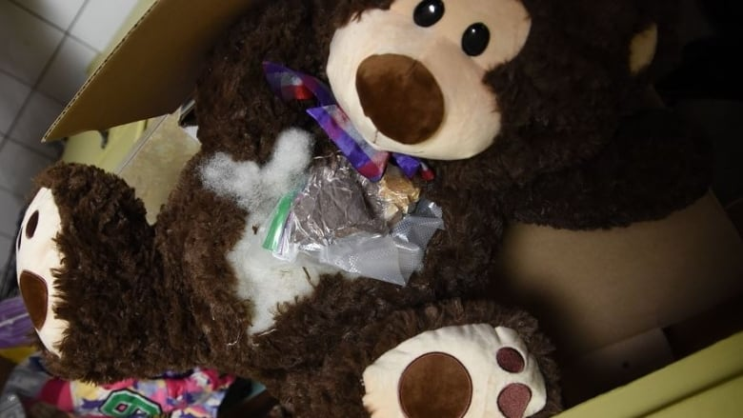
Willful Blindness
The act of deliberately choosing to ignore certain facts or information. When you tell your friends that you ”didn’t see anything” but you really saw everything.
So your ‘friend’ asks you to give another friend this Walmart teddy bear. You know there are drugs inside, but you pretend not know know. You are still guilty.

Slide 7
Recklessness
A state of acting carelessly without regard for the consequences of one’s actions.
Example: You are driving down the road and are knowingly speeding. You swerve in and out of tracffic because you are trying to get home to watch the game. You then hit another car while you are speeding through a yellow light. You didn’t intend on hitting the care, but your actions are reckless. The person in the other car is injured and you are charged with reckless driving causing bodily harm.

Slide 8
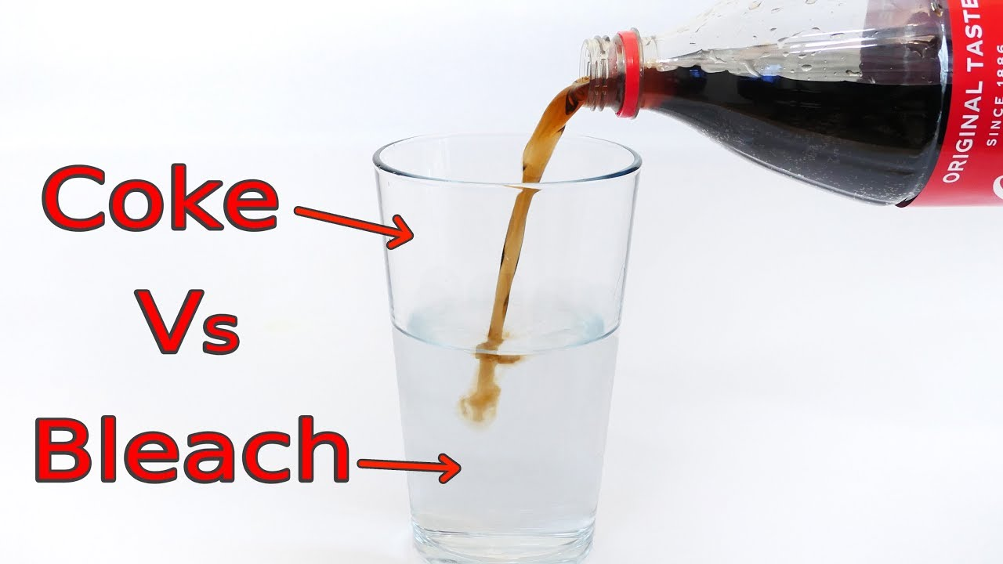
Criminal Negligence
A wanton and reckless disregard for the lives and safety of other people. This is often what a reasonable person would do vs. an unreasonable person. Ms. T decides to do her science experiments in the school kitchen not the lab and Chef Muto accidently serves her experiments instead of soup causing injury or death. A reasonable person would not use the kitchen for science experiments.

Slide 9
R. v. Collins and French, 2006 BCSC 1531 (CanLII)
Sometime in the afternoon of December 2nd 2004, victim Thelma Pete was brutally beaten, receiving approximately 25 blows to the head. Later, she was with the accused, Richard Collins and James French, in a darkened entrance to an abandoned school building where the pair were drinking alcohol At approximately 10:00pm, Collins and French took Pete by taxi to French’s apartment. They laid her on the apartment floor and continued to drink. She died from her injuries sometime during the night.
Collins and French were charged with manslaughter. The Crown did not allege that they had anything to do with her beating. The Crown argued that they were guilty of manslaughter because their actions amounted to criminal negligence. Interestingly, they would have been in less trouble if they had left Pete to freeze to death instead of taking her with them. This is because the Criminal Code states that everyone is under a legal duty to provide necessities of life to a person on his or her charge if that person is unable to care for themselves.
- How do you think the court ruled? Explain.

Slide 10
Motive
The knowledge of certain facts can also provide the necessary mens rea for a criminal conviction.
Motive is the reason for committing a certain act.
You knowingly used a cancelled credit card to try and make a purchase; that is fraud.
The reason you did this is because you wanted the newest video game; that is motive.

Slide 11
Attempt & Conspiracy
Attempt: An act done with the intent to commit a criminal offence but without success.
You attempt to shoplift from Walmart but are unsuccessful as they catch you. You are then charged with attempted theft.
Conspiracy: An agreement between two or more people to commit an unlawful act.
- During your attempted shoplift from Walmart you have your friend distract Walmart employees. They are then an accessory and involved in a conspiracy. If your friend helps you escape from Walmart with the chocolate bar, they are an accessory after the fact and are aiding and abetting – helping sometime commit the offence and encouraging someone to commit a crime.

Slide 12
R. v. Williams, 2003 SCC 41 (CanLII)
Harold Williams and the victim where in a relationship for a year that ended in November 1992. Williams had tested positive for HIV but did not tell the victim. Williams received counselling by healthcare professionals about HIV, its transmission, safter practices, and his duty to disclose his HIV status to sexual partners. However, he continued to practice unprotected sex with the victim. After the relationship ended, Williams’ partner tested positive for HIV. Williams was arrested, charged, and convicted of aggravated assault but was acquitted on appeal. The Court of Appeal substituted a conviction for attempted aggravated assault. It ruled that the crim of attempted aggravated assault must establish intent. The Crown did not like this decision and appealed to the Supreme Court of Canada. In 2001, the Supreme Court of Canada unanimously (7-0) upheld this decision. There was no way to prove the victim did not have AIDS before having sexual relations with Williams.
Was there intent, recklessness, or criminal negligence in this case? Explain.
If Williams had another sexually transmitted disease, do you think he would have been charged with aggravated assault? Why or why not?
Did Williams demonstrate motive to harm the victim?
Critics have denounced the Supreme Court’s decision as sexist and a setback for female victims of sexual abuse. Do you agree or disagree? Explain.

