Slide 1
Issues in Business
Culture and Labour

Slide 2
Culture in the Room
Do you think its important to know something about other’s in the classroom’s culture?
Do you think its important to know something about your teacher’s background and experiences? Why? What does this do for the classroom?
Discuss this in your groups for 3 minutes. Be prepared to share.

Slide 3
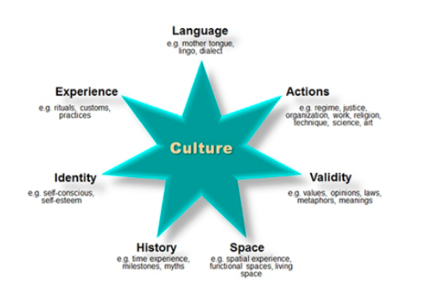
Cultural Traits
Do you think culture is learned? Look at the cultural traits, how many do you think you learned? Who / How did you learn them?

Slide 4
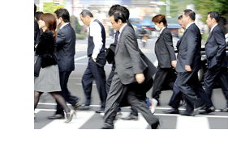
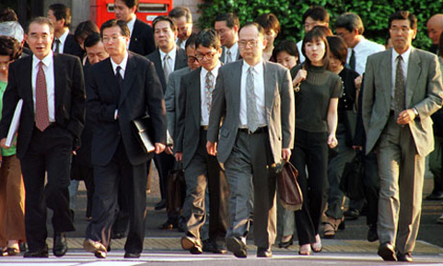
Culture and International Business
If you want to import and export or set up a joint venture (business with 2 or more owners) in another country, you need to understand the impact of culture.
Failure to understand culture could ruin negotiations, derail marking, cause a labour dispute or in some cases put a person’s life in danger.
Look at the two photos, how would you dress in a Japanese negotiation or board meeting?

Slide 5
Culture and Products
Some products, because of cultural practices have no market. For example Jewish people and Muslims do not eat Pork, so pork is not exported or sold there.
In some countries liquor is not permitted as well, and therefore there is no market for that.

Slide 6
Savings Across Cultures
Canadians save short – term for events like Christmas or long – term for university or to buy a house.
What are some events that you save for? List them. Are they the same or different as what I would save for.
Toronto Christmas Market

Slide 7
Labour and Culture
The LAW: Canadian law places an emphasis on regulating the labour force (minimum wage, hours of work, number of holidays, preventing discrimination, and to prohibit child labour)

Slide 8
Child Labour
Child Labour is prevalent in many nations:
Asia and the Pacific – 122.3 million
Sub-Saharan Africa – 49.3 million
Latin America and the Caribbean – 5.7 million
Other regions – 13.4 million
Does this mean it is culturally normal for children to work? Is this ok? How do Canadians / Americans / Europeans contribute to this phenomenon?

Slide 9
Discrimination
Canadian laws prohibit discrimination based upon race, gender, sexual preference disability and age.
Do all countries practice this? What about where you are from? Do you think Canada is really as perfect as it says?

Slide 10
Unions
“Having a union on your side makes your job and workplace safer and fairer. You get paid better and are more likely to have benefits that help you balance work with life at home. Your heath and ability to do your job become important and your right to fair treatment gets enforced.” (Canadian Labour Congress)
Do you agree? What are some benfits and drawbacks of unions. In your groups create a T-Chart listing what you think the benefits and drawbacks of unions are.

