Slide 1
Criminal Code
Summary Conviction Offences

Slide 2
The Criminal Code
Criminal law is made into law (enacted) by a democractially elected federal Parliament.
Criminal offences are treated the same across Canada.
Canada’s criminal law is found in the Criminal Code which governs society by prohibiting certain acts.
The Criminal Code is written and amended (changed) by the Federal Parliament; such as the legalization of marijuana.

Slide 3
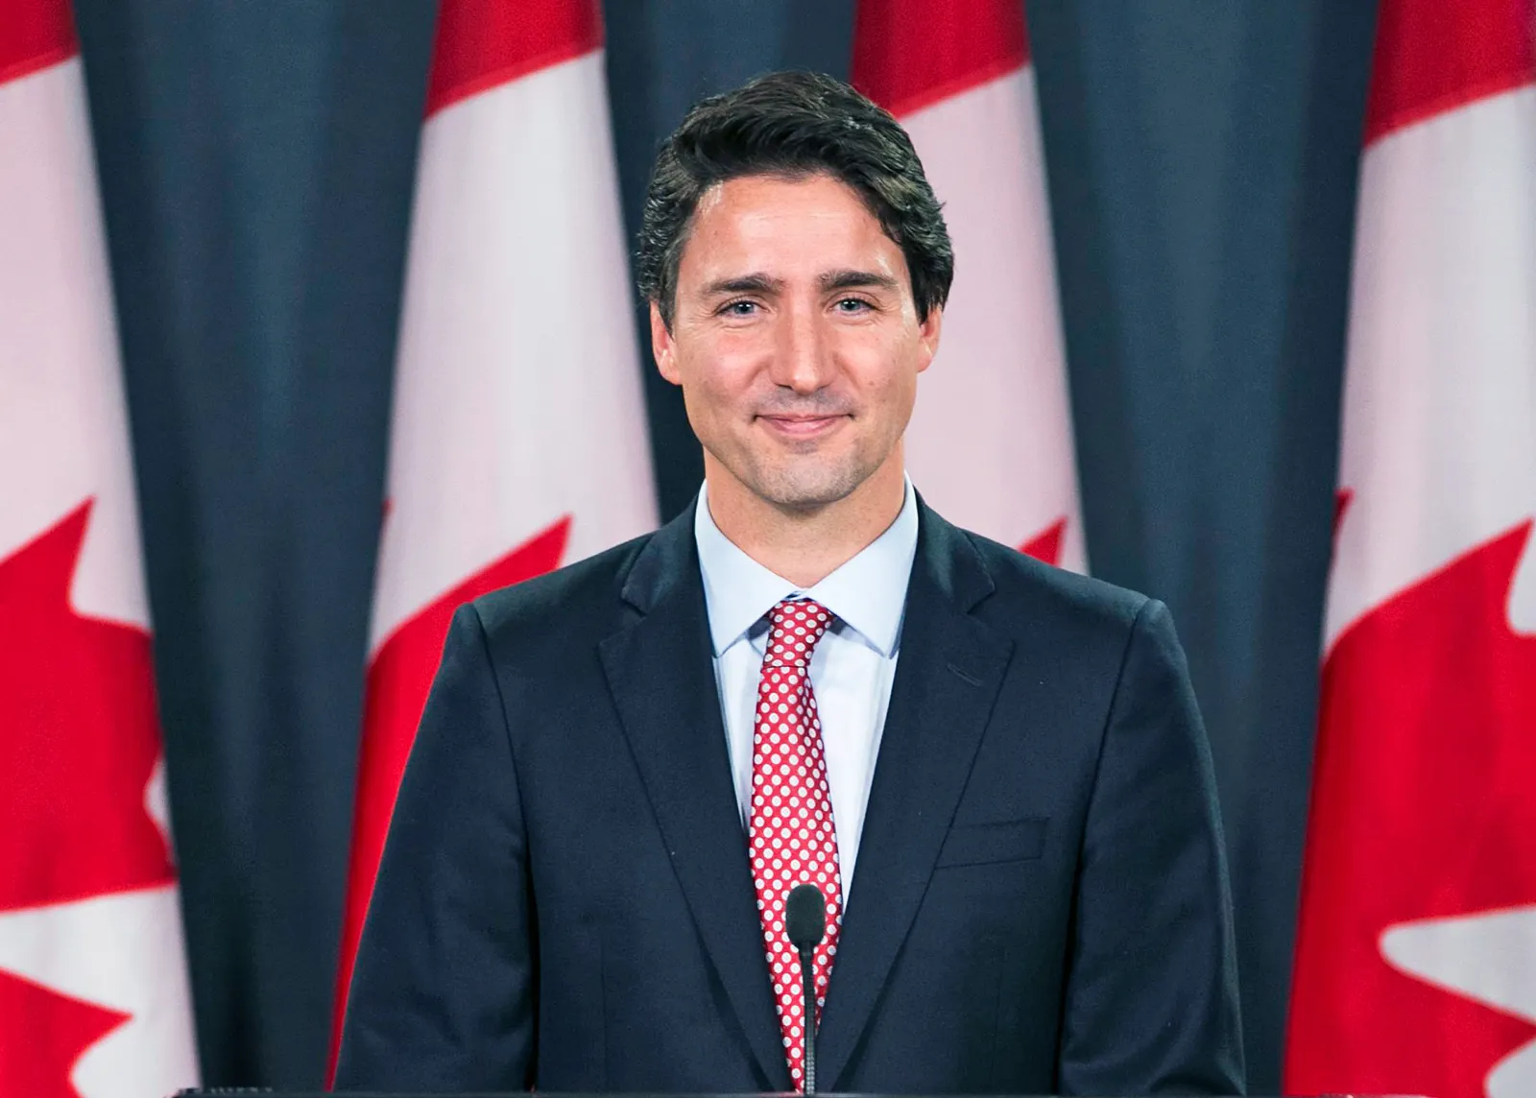
Public Law
Public Law means that the public elects officials who represent their interests (democracy) and that it is the duty of those officials to represent the interests of the people in creating or changing laws.
The Constitution Act of 1982 gives the government this power.
Laws in the Criminal Code cannot go against The Charter.
He or She is prosecuted by the Crown (Government)

Slide 4
Charter Review
Answer the following questions:
What is the Reasonable Limits clause (Section 1)?
Why is this clause so important for Criminal Law?
Who enacted The Charter?
What does Section 7 say?

Slide 5
Limit Duty Right
We need to examine the relationship between The Charter, The Duty of the Individual and The Criminal Code.

Slide 6
Summary Conviction & Indictable Offences
Summary Conviction: A minor criminal offence with less severe punishments, which is usually tried soon after the charge is laide without a preliminary hearing or jury.
Indictable Offence: A serious criminal offence with a severe penalty, proceeding by way of a formal court document called an indictment.
Hybrid Offence: A criminal offence proceeding by way of a summary conviction or an indictable offence; the Crown (government lawyers) decides which way to proceed

Slide 7
Summary Conviction Offences
Examples of Summary Offences:
Unlawful assembly
Vagrancy
Solicitation of prostitution
Harassing phone calls
Causing a disturbance in public place
Public nudity
Trespassing at night
Fraudulently obtaining transportation
In Ontario, summary conviction appeals take place in the Ontario Superior Court of Justice. These do not have a jury trial. There is generally a maximum penalty of six months in jail for summary conviction offences or up to a 5000$ fine.
A summary conviction appeal allows for the defendant to represent themselves. Of course, it is strongly advised that you seek legal advice from an expert criminal defence lawyer

Slide 8
Indictable Offences
Examples of Indictable Offences:
Breaking and entering a property
Manslaughter
Murder
Terrorism
Trafficking
Aggravated Assault
According to Canada’s Criminal Code, indictable offences are most commonly penalized through a lengthy or life imprisonment. From the date of their sentencing, the criminal could be imprisoned for up to 25 years without parole eligibility. They might also face hefty fines over 5000$.

Slide 9
Hybrid Offences
In many cases, offences might be defined as hybrid offences. This is where the act can be treated as either a summary conviction or an indictable offence. Chosen by the Crown Prosecutor, hybrid offences tend to involve crimes linked to serious but low-impact crimes such as assault, fraud or theft.
Hybrid offences carry a maximum sentence period of up to 18 months of imprisonment and fines.

Slide 10
Check Your Understanding
What is the difference between summary and indictable offences?
What choices does a Crown attorney have in dealing with hybrid offences?
Why would the Crown decide to proceed summarily rather than with an indictment?

