Slide 1
Criminal Defense

Slide 2
Criminal Defenses
Alibi
Automatism
Intoxication
Self Defense
Necessity
Duress
Ignorance & Mistake of Fact
Entrapment, Double Jeopardy, & Provocation

Slide 3
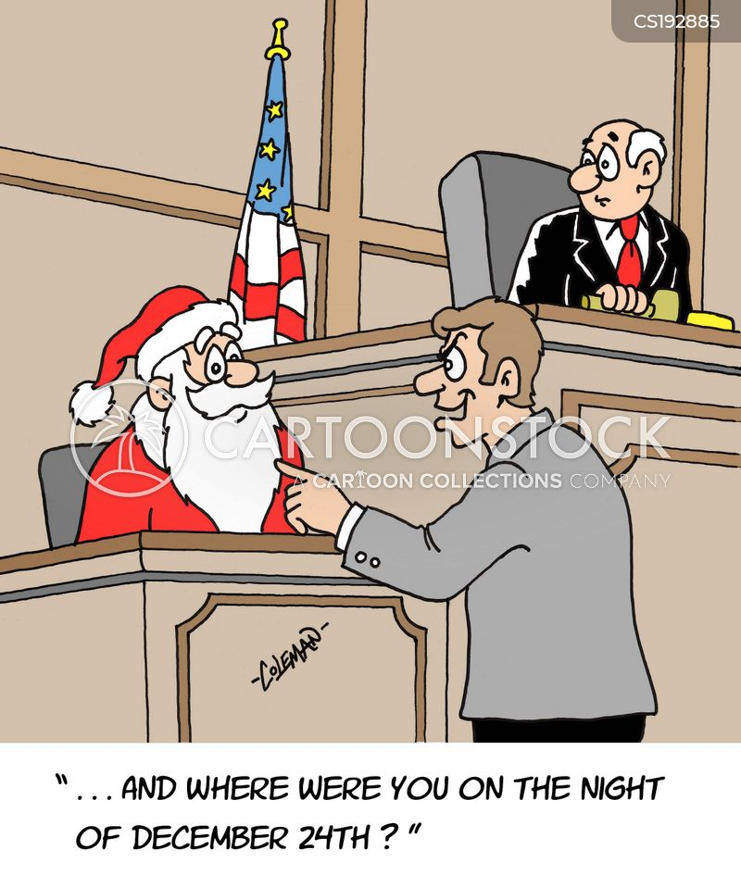
Alibi Defence
A defence that the accused was not at the scene of the crime when it took place.
The Crown must disprove this defence
It has 3 parts:
Statement indicating the accused was not present.
An explaination of the accused whereabouts
Names and witnesses to the alibi

Slide 4
Non – Insane Automatism
Involuntary action by someone who is in a sate of impaired consciousness, without control over his or her actions
Defined: as automatic functioning without conscious effort or control. In other words an individual has no control over his or her actions but is still capable of committing an act (breathing or blinking for example).
Example: you get a blow to the head or have a stroke, can still function, and commit a crime.
Go to our website and read the updated article. Do you agree or disagree with this recent Supreme Court Decision.

Slide 5
Insane Automatism
Insane automatism is caused by a disease of the mind = NCR (not criminally responsible) because of a disease of the mind.
Criminal Code
16 (1) No person is criminally responsible for an act committed or an omission made while suffering from a mental disorder that rendered the person incapable of appreciating the nature and quality of the act or omission or of knowing that it was wrong.
A Fitness Hearing
Does the accused understand the nature of the proceedings?
Does the accused understand the possible consequences of the proceedings?
Can the accused communicate with his or her lawyer?
If they are declared unfit for trail, the judge will decide the sentence and determine if the accused poses a significant threat to society. (Read the article and answer the questions on our website)

Slide 6
Defences That Provide A Reason for the Offence
Evidence to the Contrary: Evidence that disputes the evidence put forth by the Crown.
Battered Woman Syndrome: a psychological condition caused by severe domestic violence. R v. Lavallee held that prolonged abuse was an insane automatism defence. In the case Lavallee shot her partner in the back of the head as he left as he said he was coming back and was going to “kill her”.
Self – Defence the legal use of reasonable force in order to defend oneself.
Necessity is when you commit a criminal act due to “immediate an urgent circumstances”. Speeding to take your mother to the hospital as she suffers from a stroke.
Duress: You participate in a crime because of a threat

Slide 7
Other Defences
Ignorance: to not know the law is not an acceptable defence. Mistake of fact shows a lack of mens rea (an honest mistake).
Entrapment: police action that induces a person to commit an offence. This is different than a sting where police observe a crime.
Double Jeopardy: if you are tried and acquitted of a crime, you cannot be tried for the same crime 2x.
Provocation: An accepted legal defense inciting to commit a crime in the heat of passion. Can reduce a charge from murder to manslaughter.

Slide 8
REFLECTION
Law & Order: What defence(s) are used? Which were effective or not?
Mock Trial: What defence could be used? Why or why not?

