Slide 1
Theme: Methods of Control
Bokanovsky process, hypnopaedic conditioning, war, drugs

Slide 2
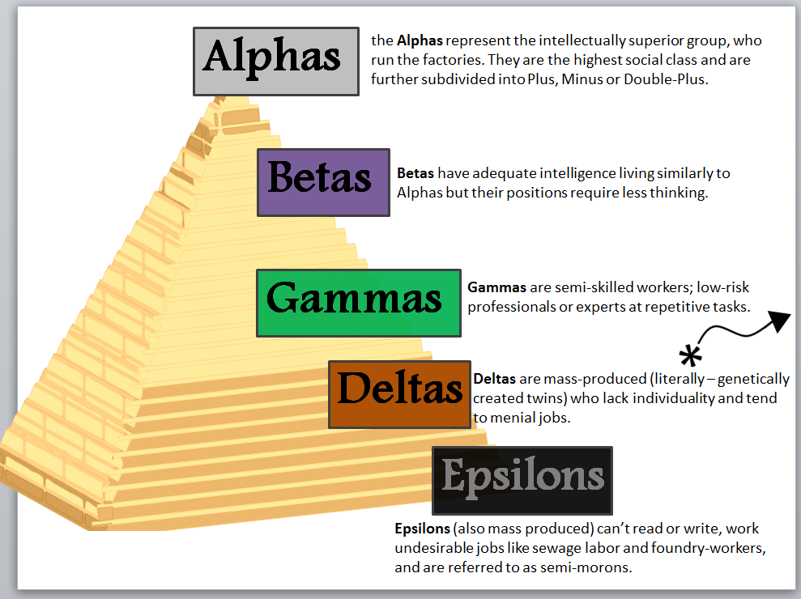
Caste System in Brave New World
Ironically “khaki” – the color of the “Deltas” is very significant and symbolic.
The color khaki was coined in British India – derived from the Hindustani language from the word khak meaning soil. Ironically – India’s caste system, predicated on Hinduism, features a tiered, rigid, social pyramid that labels the lower castes as “untouchable” because they are believed to be unclean.

Slide 3
Caste Manipulation
Page 17 – How is technology used to manipulate the castes?
Notes:
The Delta babies succumb to very loud noises and electric shocks when they see books and flowers so to suppress their desire to read and be education as well as have affection for beauty and want to take vacations from work. This socially constructs them into the caste they are in and creates a workforce that has no desire to educate themselves or find love/beauty in anything.

Slide 4
Sleep Suggestion
Technology: We see how sleep suggestion is used to manipulate the various castes and how they control one castes feeling of another, “Alpha children wear grey. They work much harder than we do because they’re so frightfully clever.” (pg 22)
How is this an example of technology being used to control society?
What are the results of this sort of suggestion?

Slide 5
War and Science
“…the explosion of the anthrax bombs is hardly louder than the popping of a paper bag.” (pg 41)
“The Russian technique for infecting water supplies was particularly ingenius.” (pg 41)
Why are these dangerous uses of science?
How does this mirror society today?

Slide 6
Reproductive Technologies
How does the control over sex and birthing technology represent a very important part of government control?
The Hatching Center re-enforces the caste system. You are born and chosen to be what caste you will be and are given no choice of what you can become.

Slide 7
Soma
“Two thousand pharmacologists and biochemists were subsidized in A.F. 178.” (pg 45)
Read Page 46. What do you think the passage, “All of the advantages of Christianity and alcohol; none of the defects.” and “Take a holiday from reality whenever you like, and come back without so much as a headache or mythology.” means?
Think about this and discuss for 5 min with your group

Slide 8
Soma
What does Soma do? Do you know of anything in today’s society that does the same thing as Soma?
What are the effects of Soma?
Why do you think the Government would give its people Soma?

Slide 9
Science and Technology Critical Analysis
Individually reflect on the following questions and then write, using 2 examples, a response to the questions below. Be sure to write in full sentences and to review your handout on what makes a good paragraph.
Who has access to science and technology?
What does this tell us about science and technology in this society?
What are their purposes and provide 2 examples from the book to support your opinion.

