Slide 1
The Constitution

Slide 2
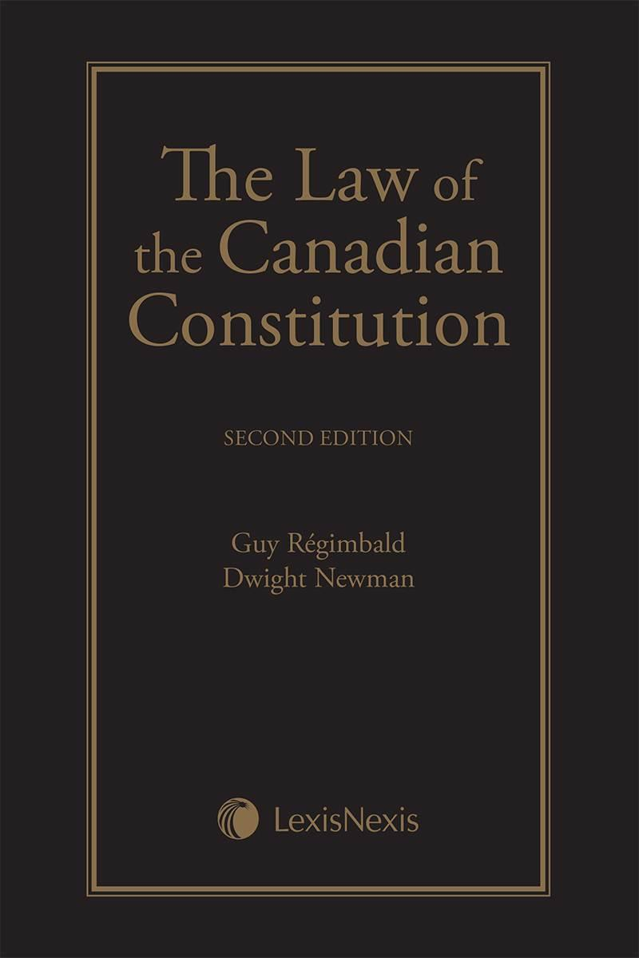
What is the Constitution?
Provides a fundamental framework on which all other laws are based.
Sets out procedures for making laws and defines who will be involved in making them.
Its like a nation’s rulebook

Slide 3
Canada’s Constitution
Founded on ideas of freedom, equality and democracy.
Has rules that everyone including government must follow.
Rules reflect Canadian value systems.
A constitution however, does not guarantee that all will abide by said rules or that everyone has the same shared values.
What are some values that might differ amongst Canadains? Why might they differ?

Slide 4
How Canada Operates
3 Main Sources of Canadian Constitution
1. Written Constitution 1867 (BNA)
2. Unwritten Rules & Conventions
3. Court Rulings

Slide 5
#1: The British North American Act A Case Study of Systemic Racism
Canada became a country in 1867 (Ontario, Quebec, New Brunswick, and Nova Scotia).
Legislation drawn up by British Parliament
Changes had to be passed through British Parliament
1982 Renamed the Constitution Act and The Charter of Rights and Freedoms was added
Federal System was adopted to cater to different needs of diverse people across Canada
In 1867, the Constitution Act assigned legislative jurisdiction to Parliament over "Indians, and Lands reserved for the Indians."
Watch the video history on our website. Reflect: Who determines justice?

Slide 6
Indian Act 1867- Legal Systemic Racism
Subsumed a number of colonial laws that aimed to eliminate First Nations culture in favour of assimilation into Euro-Canadian society.
Gave the government sweeping powers with regards to First Nations identity, political structures, governance, cultural practices and education.
These powers restricted Indigenous freedoms and allowed officials to determine Indigenous rights and benefits based on “good moral character.”
Forbade First Nations peoples and communities from expressing their identities through governance and culture.
Replaced traditional structures of governance with band council elections.
illegal for First Nations peoples to practice religious ceremonies and various cultural gatherings. In 1884, the potlatch was banned, and in 1895, “any Indian festival, dance or other ceremony,” which would include powwows and the sun dance, were also are banned.

Slide 7
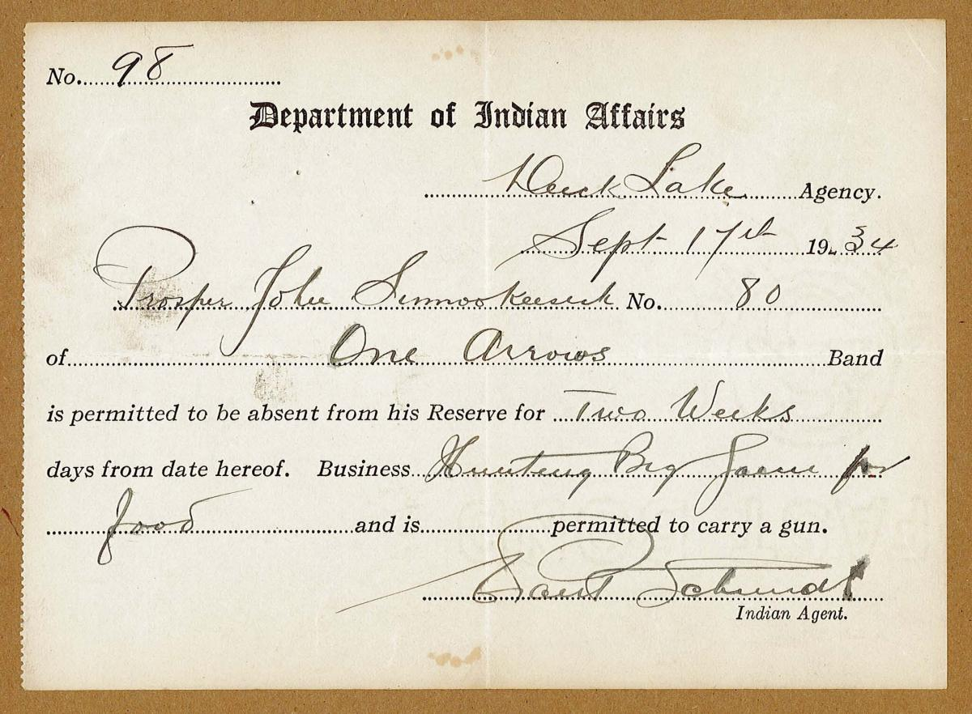
Some Amendments
In 1927, the Act made it illegal for First Nations peoples and communities to hire lawyers or bring about land claims against the government without the government’s consent.
required First Nations children to attend industrial or residential schools (1894 and 1920).
1885 Pass system: Indigenous people had to present a travel document authorized by an Indian agent in order to leave and return to their reserves.
Visit our website and learn more about the effects of The Pass System

Slide 8
Exclusion of Women
Defined who was considered an Indian under the law. It stated that an Indian was “any male person of Indian blood reputed to belong to a particular band.”
Indian status also applied to “any child of such person” and to “any woman who is or was lawfully married to such person.”
1951 women were able to vote in band council elections
1951 amendments gave the provinces jurisdiction over Indigenous child welfare, leading to ‘60s scoop’
Visit our website to see the long-lasting effects of systemic racism.

Slide 9
#2 Canada’s Unwritten Constitution
Canada will be federally united with a “constitution similar in principle to that of the United Kingdom.”
While there is no ‘official’ word Prime Minister, Cabinet system, party system or parliamentary democracy, they are created in the mirror image of the British system.

Slide 10
#3 Court Decisions
When there is a dispute over the meaning or intent of certain sections, phrases and even individual words within the constitution, the courts are called upon to resolve it.
More on this soon with The Charter of Rights and Freedoms.

Slide 11
Education
Education received a separate section (s.93) in the 1867 Constitution. But today we question the guarantees provided and beg the question: What schools should receive government funding? Read the section you have been given from the text and answer the questions. (pg. 110 – 111) Be prepared to discuss.

