Slide 1
An Introduction to a Brave New World
The Hatchery

Slide 2
Brave New World
A novel written in 1931 by Aldous Huxley and published in 1932.
Set in London of AD 2540 (632 A.F.—"After Ford"—in the book)
The novel anticipates developments in reproductive technology, sleep-learning, psychological manipulation, and classical conditioning that combine profoundly to change society.

Slide 3
Dystopia
A community or society that is in some important way undesirable or frightening. It is the opposite of a utopia.
How have we seen so far that this society is a dystopia not a utopia? Hint! What makes you feel uncomfortable?

Slide 4
Bokanovsky’s Process
What is Bokanovsky’s Process?
“One egg, one embryo, one adult – normality.”
How does Bokanovsky’s Process differ from this? Find the Passage that explains this and read it over again.

Slide 5
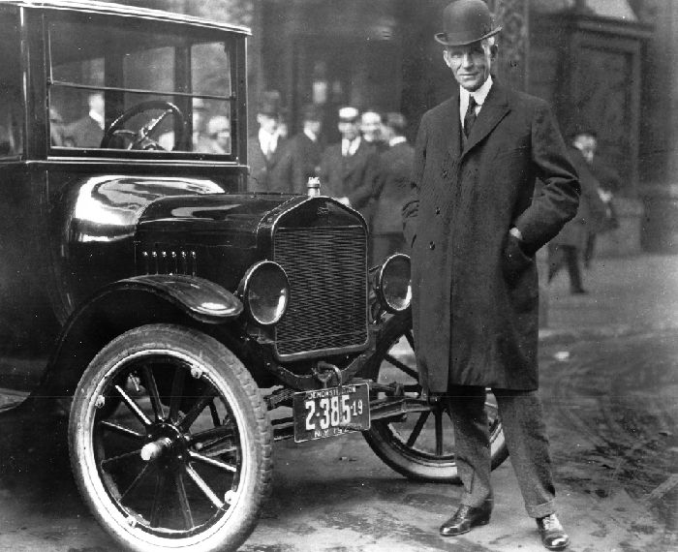
Progress.
After Ford (A.F.) : Henry Ford and the production of his first car (the Model T.)
Humans are no longer produced naturally, but are grown.
They are nurtured and pre-destined to do jobs or be certain members of a caste system.
How is this like you would create a car?

Slide 6
Social Structure
Humans are standardized in the ‘Hacthery.’
The Director and Mr. Foster explain the purpose of this.
A great number of the lower castes are sterilized. Why would they do sterilize the lower castes?

Slide 7
Differences Among Classes
Higher Castes: Members of the higher castes are decanted one by one, without any artificial intervention. Thus the higher castes retain at least some level of the individuality and creativity.
Lower Castes: Sterilized, given liquor or drugs and deprived of oxygen in order stunt their mental capacity (pg 10), are vaccinated in order to have their bodies immune to their working conditions (pg 13) and are conditioned to survive severe working conditions such as those in mines (pg 13 bottom)

Slide 8
Creative Writing Task
“A SQUAT GREY building of only thirty – four story's. Over the main entrance the words, CENTRAL LONDON HATCHERY AND CONDITIONING CENTRE, and, in a shield, the World State’s motto, COMMUNITY, IDENTITY, STABILITY.”

Slide 9
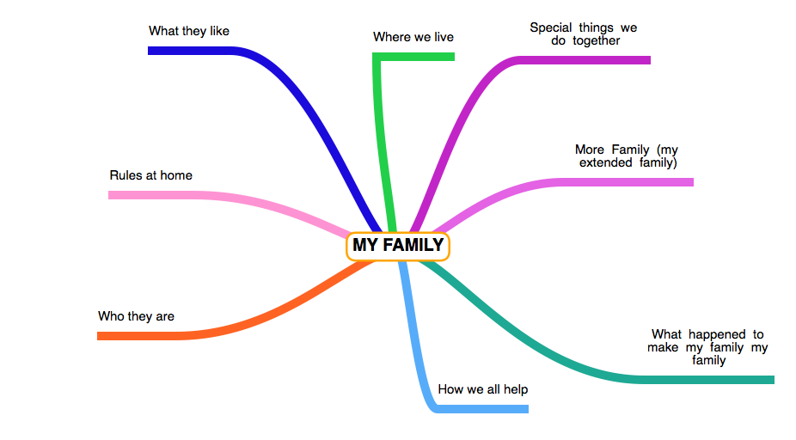
The Opening
What does this paragraph make you feel?
What sort of tone does it set for the novel?
Can you take apart the first paragraph, what information does it give us?

Slide 10
Brave New World Comprehension Questions
This term you will have to complete all comprehension questions (its like free marks) and then hand them in at the end. You will also hand in a reflection. The assignment is on the website. We will go through it together.

