Slide 1
Brave New World
Happiness, Spirituality, and a Review

Slide 2
Happiness
What is happiness? I might say its being content. You might say its when you win at a video game. Either way, happiness is subjective. Happiness is also individualistic and an emotion; two things the World State does not like.
"..there is always soma, delicious soma, half a gramme for a half-holiday, a gramme for a week-end, two grammes for a trip to the gorgeous East, three for a dark eternity on the moon...” - Lenina
How does the World State substitute for individual happiness? --------------------- >
“You can't make tragedies without social instability. The world's stable now. People are happy; they get what they want, and they never want what they can't get. They're well off; they're safe; they're never ill; they're not afraid of death; they're blissfully ignorant of passion and old age; they're plagued with no mothers or fathers; they've got no wives, or children, or lovers to feel strongly about; they're so conditioned that they practically can't help behaving as they ought to behave.” - Mond
What do you think about what Mond says?

Slide 3
Spirituality
Religion has been replaced with technology and the World State.
What has religion been replaced with in our society? Do you see connections here? How do people distract from misery in our society?
“You remind me of another of those old fellows called Bradley. He defined philosophy as the finding of bad reason for what one believes by instinct. As if one believed anything by instinct! One believes things because one has been conditioned to believe them. Finding bad reasons for what one believes for other bad reasons-that’s philosophy. People believe in God because they’ve been conditioned to.” – Mond pg 160
“But all the same,” insisted the Savage, “it is natural to believe in God when you’re alone-quite alone, in the night, thinking about death .”
“But people never are alone now,” said Mustapha Mond. “We make them hate solitude; and we arrange their lives so that it’s almost impossible for them ever to have it.” pg 160

Slide 4
The Brave New World Review Activities:
The next 7 slides provide some review questions to think about when writing your essay or reviewing for a final task. Complete all slides to increase your success in the course.
It is a dystopia. What is a dystopia and what are some examples that prove it is a dystopia?

Slide 5
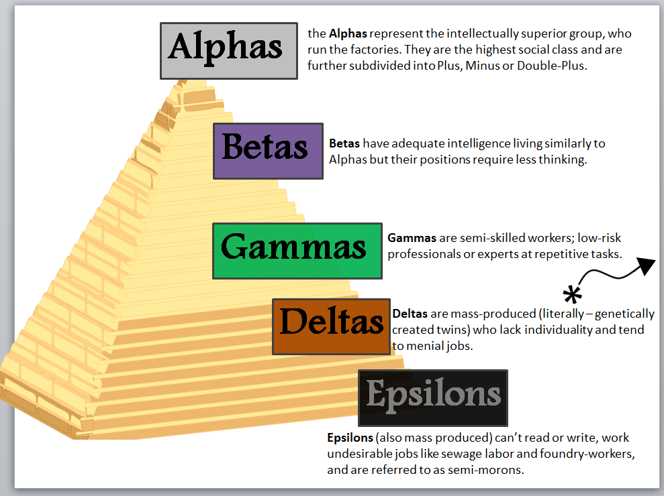
Major Themes
Control: Who has control?

Slide 6
Use of Technology
What is? Why is it important?
Sleep – Teaching/Hypnopedia:
Anthrax Bombs:
The Reservation:
Helicopters/Planes:
The Hatchery:
The Games:
Henry Ford:

Slide 7
Major Characters
Bernard Marx is a malcontent who rages against the New World government in private but is too afraid to do so in public. He is fickle and has low self esteem. When he gains power and popularity because of John he suddenly likes the New World and has many women and high status.

Slide 8
The Controller and Helmholtz
Compare and contrast Helmholtz to Bernard. What makes them different and what makes them similar?
Explain Mond’s individuality and what makes him different from everyone else. Why does society need someone like this to run it?

Slide 9
John the Savage
John is from the reservation and is the son of the Director and Linda. He reads Shakespeare and detests the New World. He believes in love. Falls in love with Lenina and eventually kills her by whipping her to death.
Look up the definition of a ‘Tragic Hero’. Is John a tragic hero? Why or why not?

Slide 10
The Women
Choose 3 Feminist Criticism Questions and ask these questions of the book. Find specific answers and provide a Feminist analysis of the book. Then ask yourself: Does this book represent women well or not?

Slide 11
Marxism
Review the Marxism PowerPoint.
What is the message about social organization or class difference from the story? How does this relate to equality and freedom?

